Slide 1
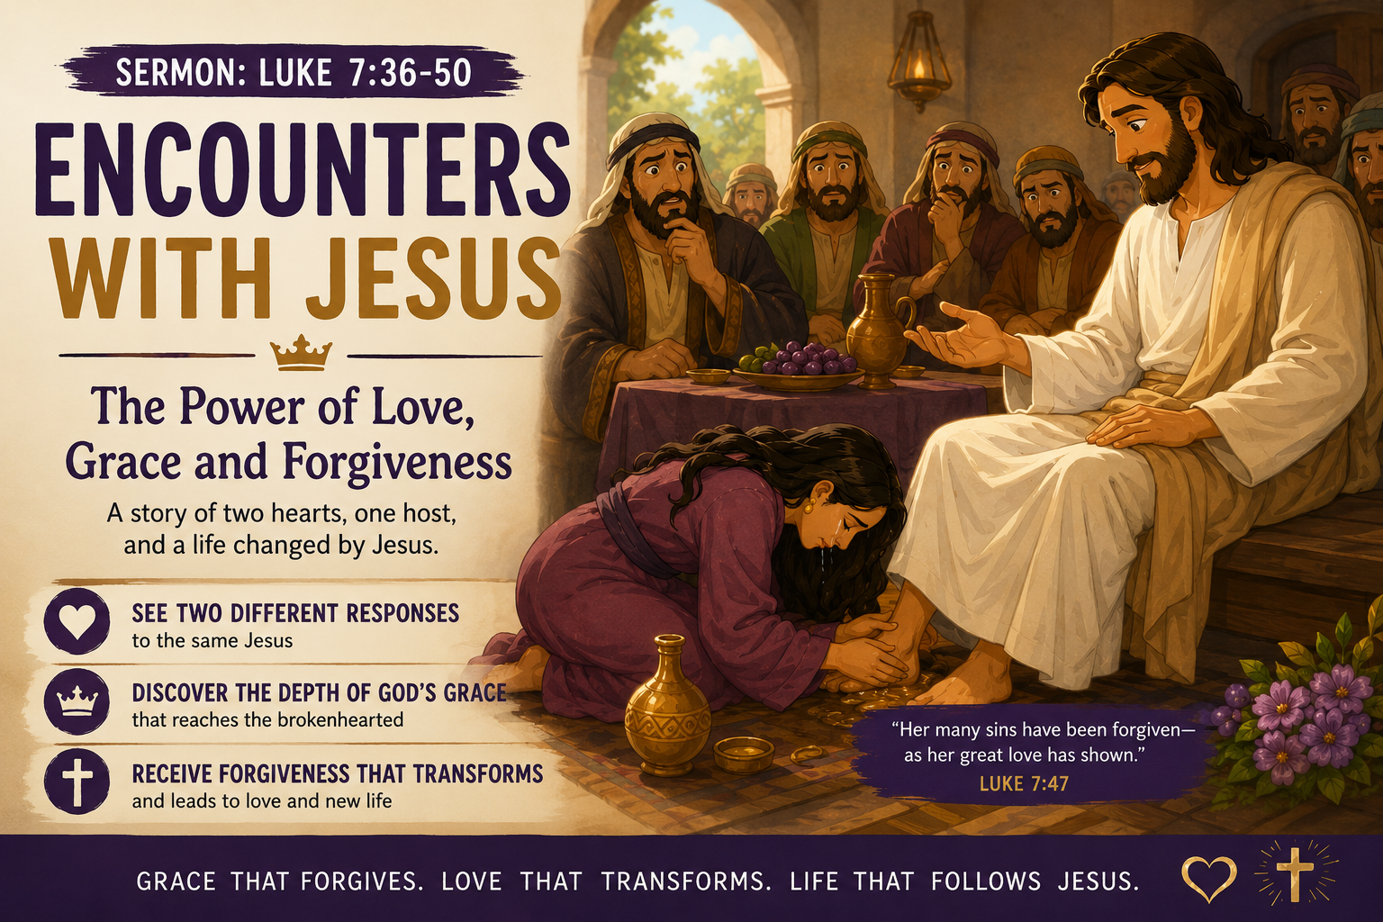
Encounters With Jesus:
The Power of Love, Grace and Forgiveness
Text: Luke 7:36–50

Slide 2

Content
The Encounter- What does an encounter mean?
Two People, Two Responses
Come to Jesus as You Are
The Danger of a Judgemental Heart
Grace Cancels a Debt We Cannot Pay
Forgiven People Love Differently
Go in Peace: Grace Gives You a New Future
Personal Reflection & Discussion for Community Group

Slide 3
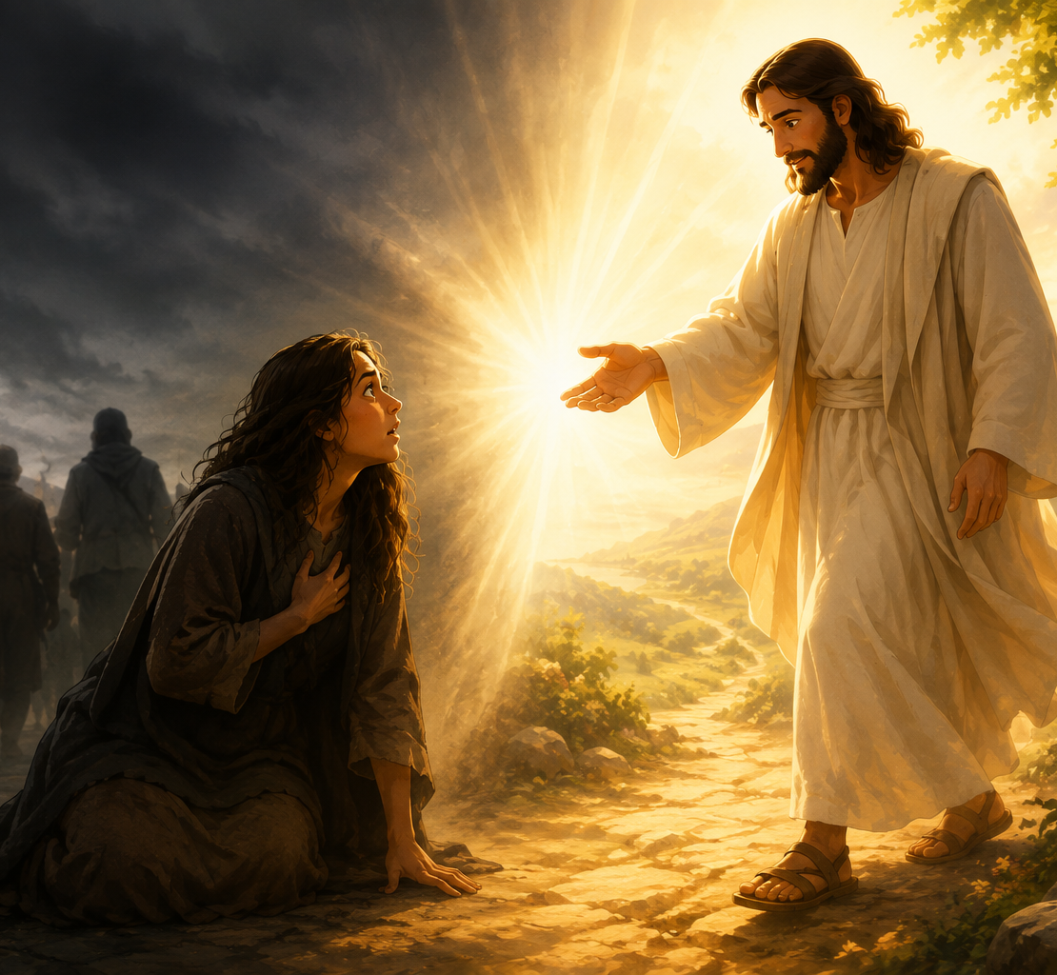
The Encounter- What does an encounter mean?
An Encounter is to meet someone UNEXPECTEDLY or to be UNEXPECTEDLY faced with or experience something (hostile or difficult).
However, with Jesus, this becomes a positive, massive life changing experience.

Slide 4
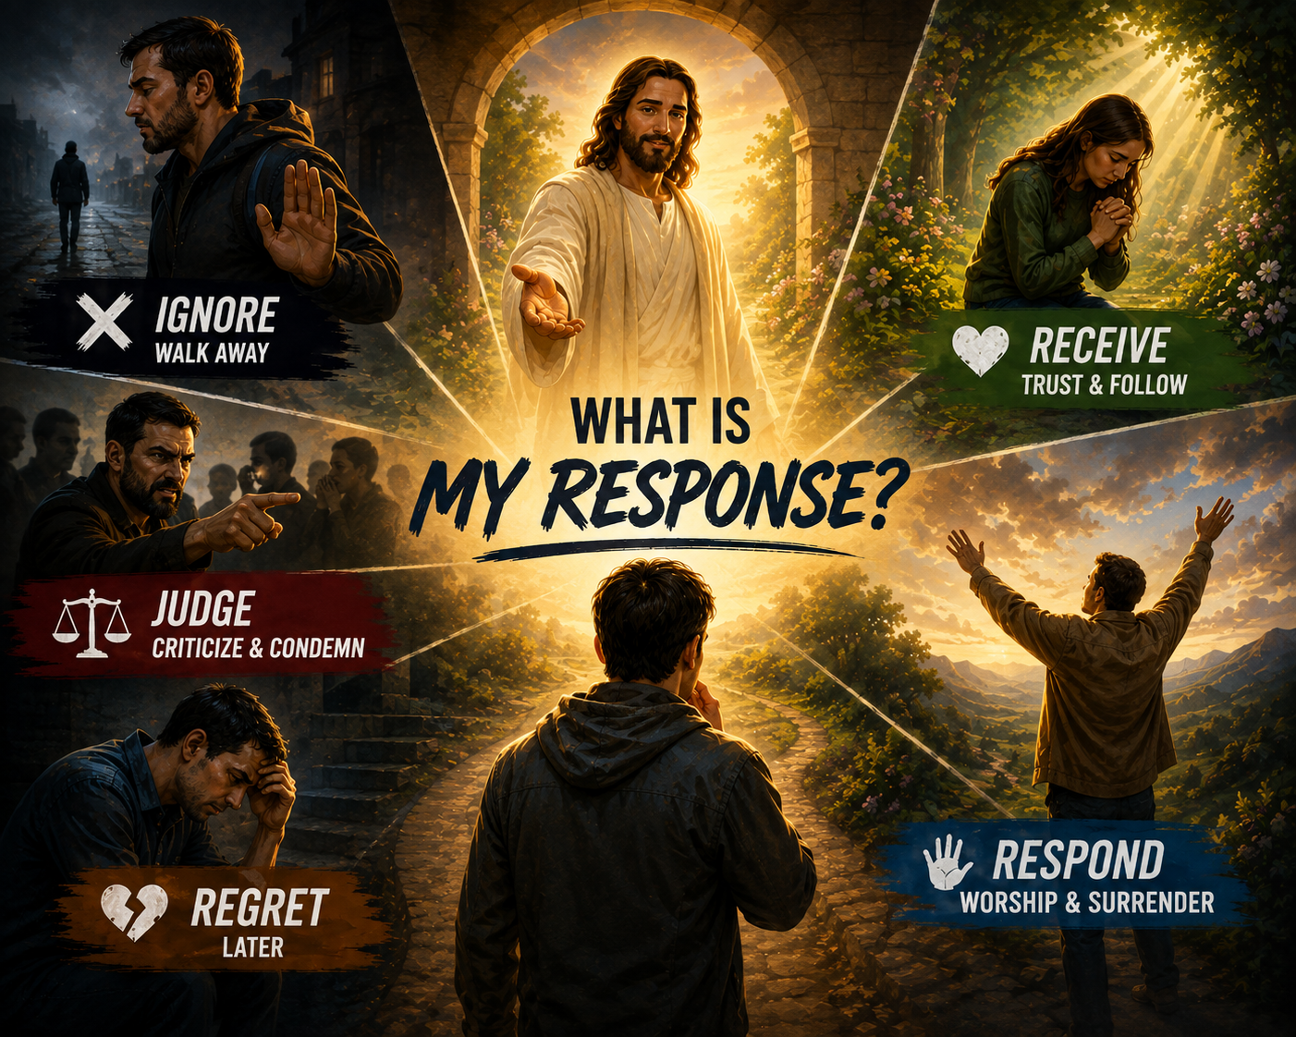
Two People, Two Different Responses
SIMON
Invited Jesus into his house
Offered little honour
Watched and judged
Questioned Jesus
THE WOMAN
Came knowing her need
Wept at Jesus' feet
Gave something precious
Loved extravagantly

Slide 5
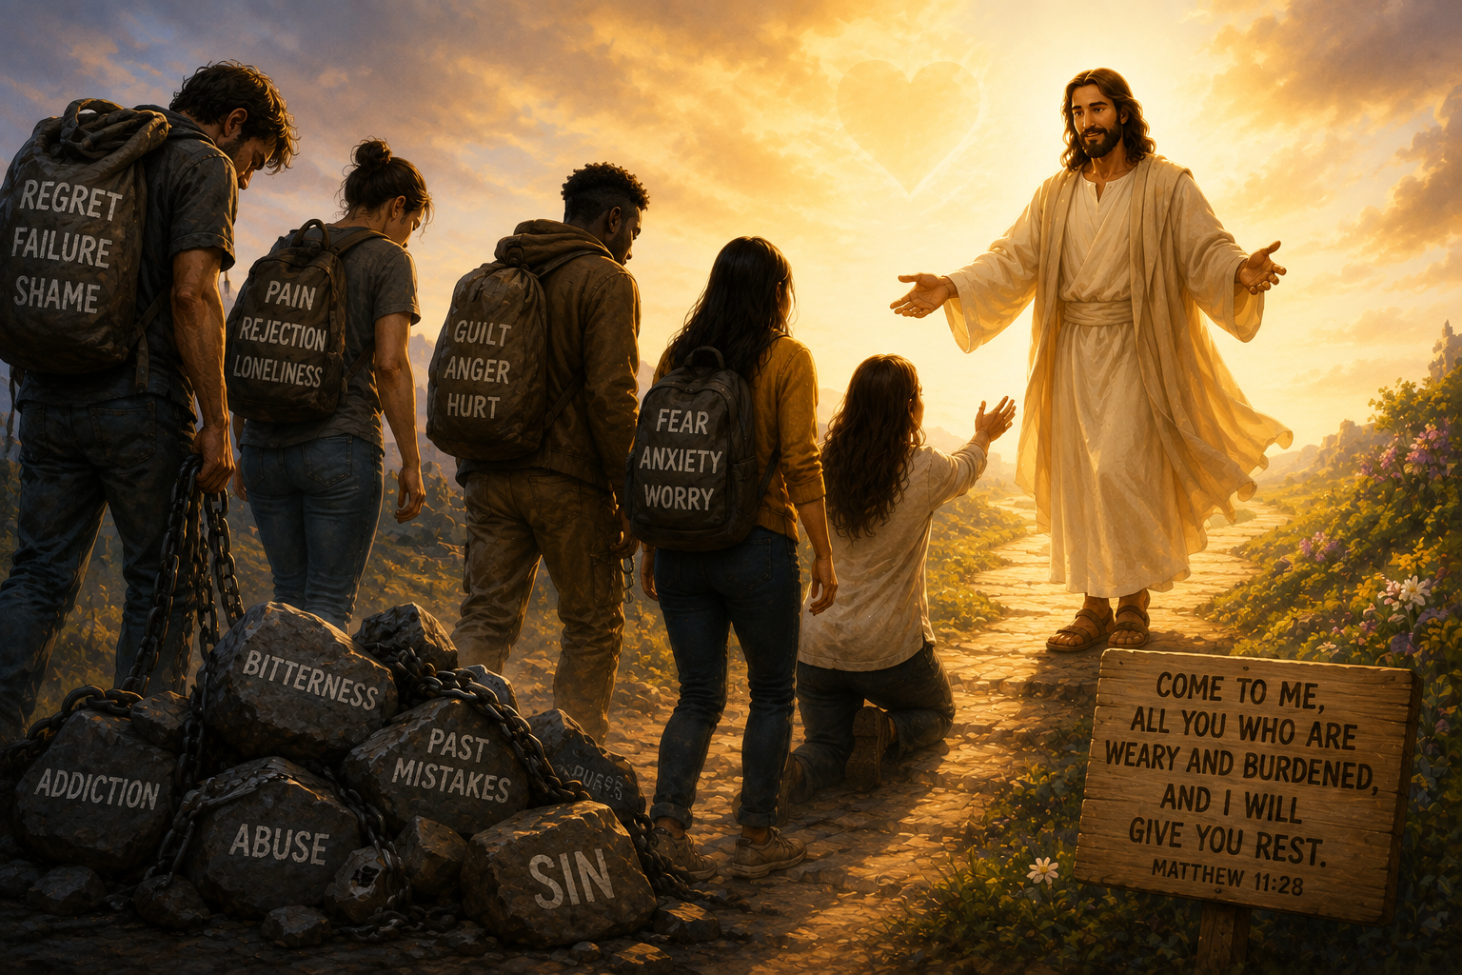
Come to Jesus as You Are!
She came despite her past; she brought it with her-
Her tears
Her brokenness
Her worship
Her alabaster jar
“She stood behind him at his feet weeping…” — Luke 7:38
She stood behind him because she was aware of all she came with, yet it did not stop her.

Slide 6
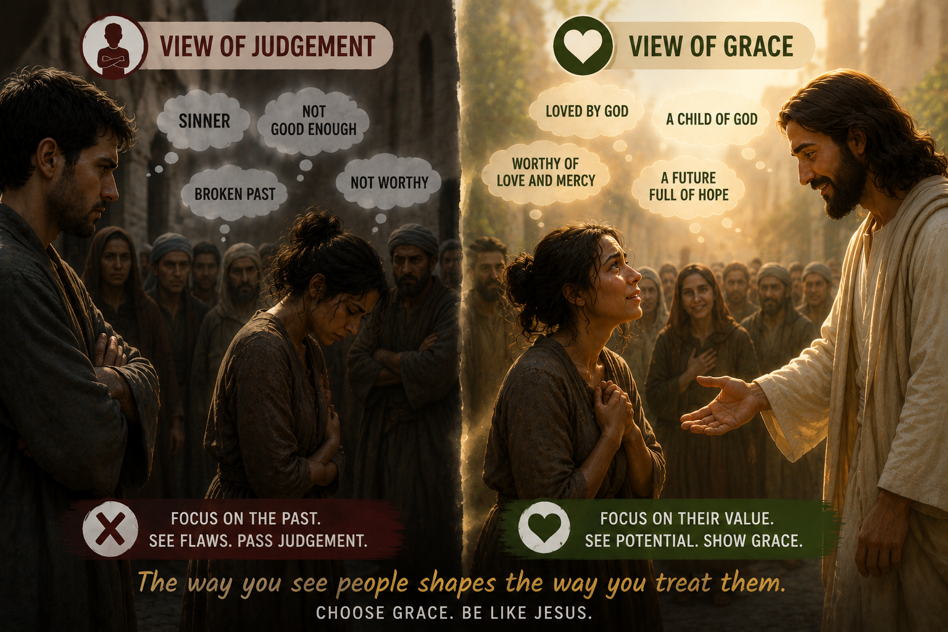
The Danger of a Judgemental Heart
Simon saw- “A sinful woman.”
while
Jesus saw- A person who needed grace.
Be careful when you become more conscious of someone else's sin than your own need for grace.

Slide 7

Grace Cancels a Debt We Cannot Pay
TWO DEBTORS- 500 denarii | 50 denarii
One problem: Neither could pay.
One solution: Both were forgiven.
GRACE
The debts were different, but the condition was the same: neither could pay.
Our failures may look different; some are public, others hidden but none of us can earn God's forgiveness.
Forgiveness is not earned; it is grace.
At the feet of Jesus, we all come needing grace.

Slide 8
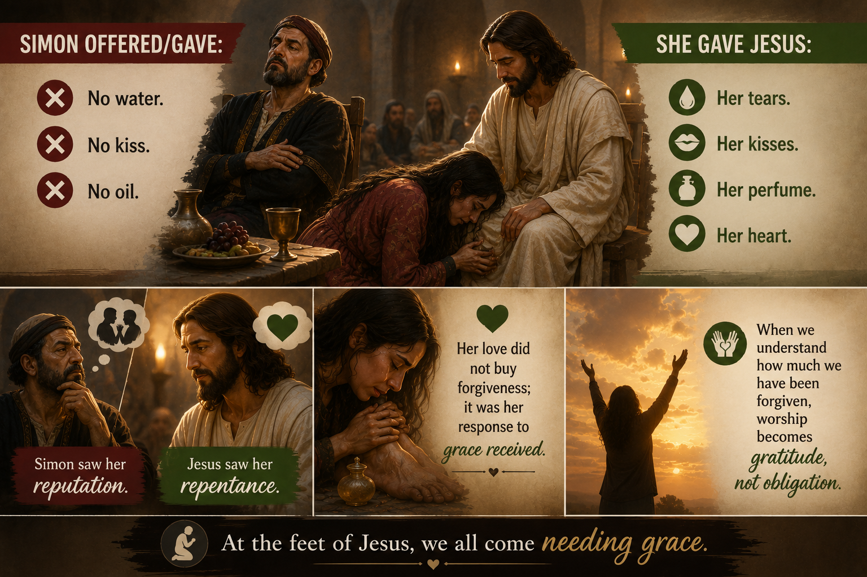
Forgiven People Love Differently
Simon offered/gave:
No water. No kiss. No oil.
She gave Jesus:
Her tears. Her kisses. Her perfume. Her heart.
Simon saw her reputation.
Jesus saw her repentance.
Her love did not buy forgiveness; it was her response to grace received.
When we understand how much we have been forgiven, worship becomes gratitude, not obligation.

Slide 9
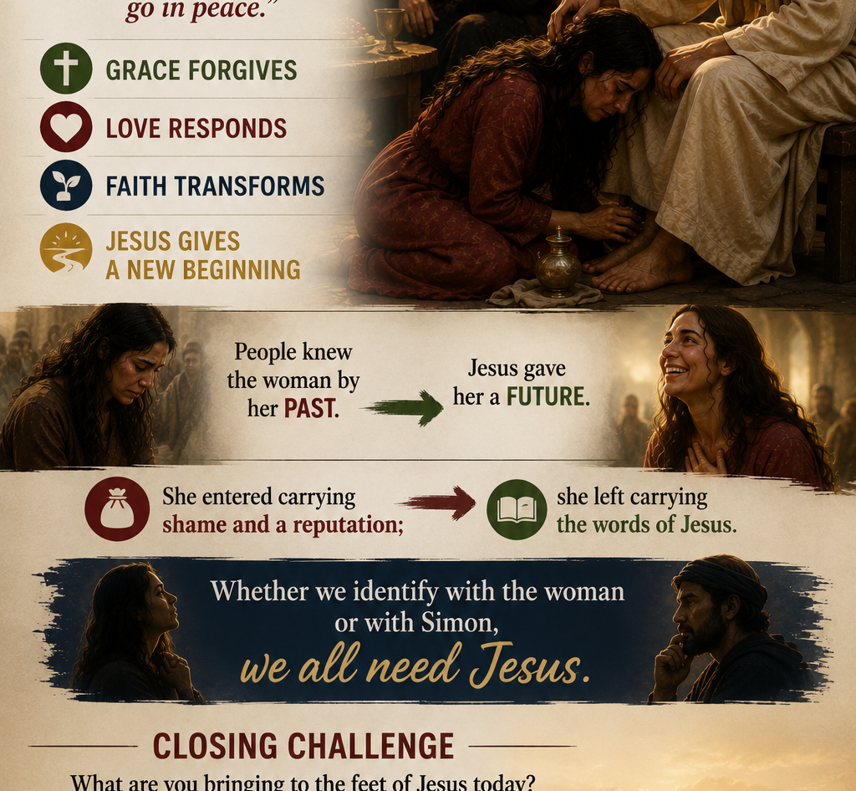

Go in Peace: Grace Gives You a New Future
Jesus Gets the Final Word- “Your sins are forgiven.” “Your faith has saved you; go in peace.”
GRACE FORGIVES
LOVE RESPONDS
FAITH TRANSFORMS
JESUS GIVES A NEW BEGINNING
People knew the woman by her past. Jesus gave her a future.
She entered carrying shame and a reputation; she left carrying the words of Jesus.
Whether we identify with the woman or with Simon, we all need Jesus.
Closing Challenge
What are you bringing to the feet of Jesus today? - Your past? Your guilt? Your pride? Your brokenness?
Bring it to Him.

Slide 10
Personal Reflection & Discussion for Community Group
1. The Woman
What gave the woman the courage to approach Jesus despite her reputation and the judgement of others?
2. Simon
Why do you think Simon could see the woman's sin but struggled to recognise his own need for grace?
3. Jesus
What does the way Jesus treated the woman teach us about God's character?
4. Forgiveness & Love
How should understanding God's forgiveness change the way we love Him and other people?
5. Personal Reflection
Who do you identify with most in this story; the woman or Simon? And why?
6. Taking It Home
What is one practical change you can make this week because of what you have heard today?
And finally- WHAT AM I BRINGING TO THE FEET OF JESUS TODAY?

Slide 11


